Slide 1
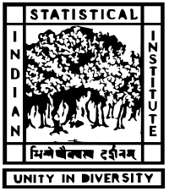
INDIAN STATISTICAL INSTITUTE
Assignment 1 Presentation
By
Subhrajyoty Roy
Roll- BS1613

Slide 2
Introduction
My assignment concerns with basic analysis and interpretation of data about the school life educational overview in India in the year 2007-08. This also demonstrates how each individual states distributed trained teachers among various degree of educational standards (say Primary, Middle, Secondary etc) in schooling in 2007-08.
Source of the Data
The data is collected from a website www.data.gov.in. Department of Education, Ministry of Human Resource Development has uploaded that there.

Slide 3
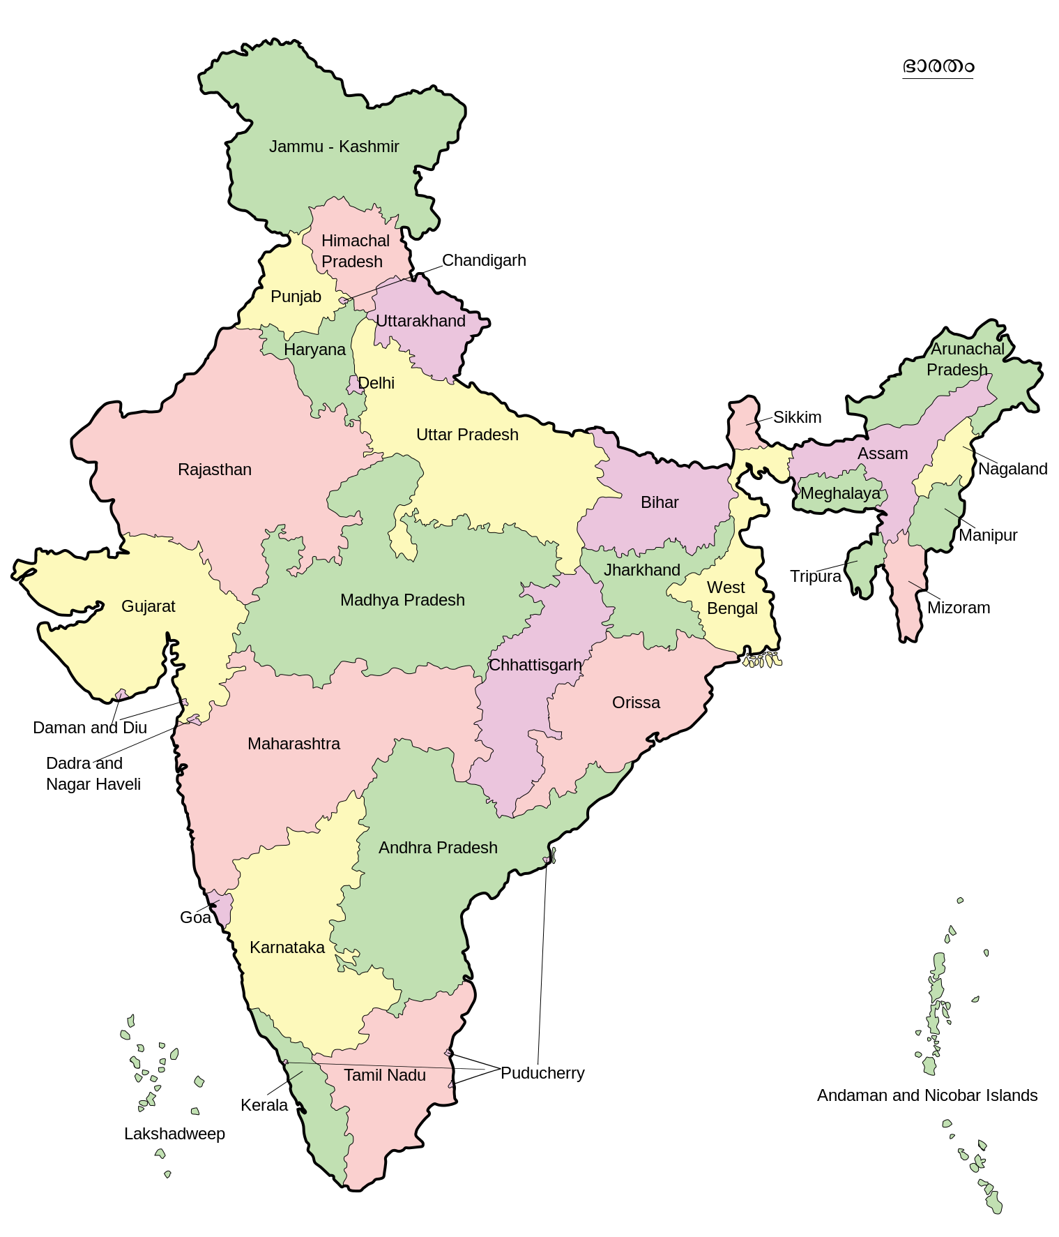
This picture shows the distribution of trained teachers in different states of India
60%
100%
99.5%
100%
94%
100%
27%
96%
46.9%
The states in eastern zone has relatively low amount of trained teacher, while there are more % of trained teachers in states of southern zone and around Delhi.
84%
24%
91%
38%
37%
100%
58%
100%
85.5%
82%
43%
67%
92%
97.8%
94.21%
94%
100%
98.3%
100%
100%

Slide 4
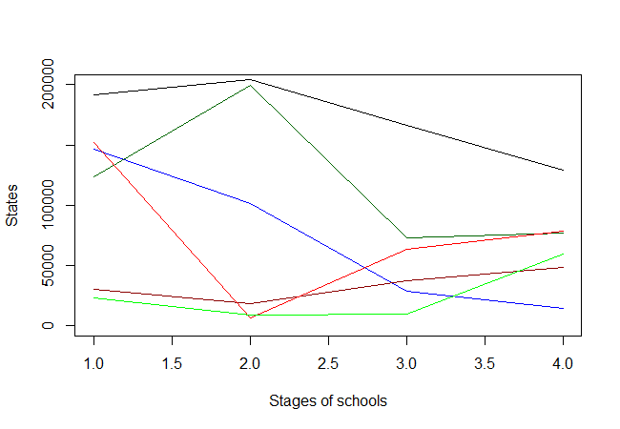
Distribution of Total teachers in some selected States of India
Maharashtra
Rajasthan
Bihar
West Bengal
Haryana
Delhi

Slide 5
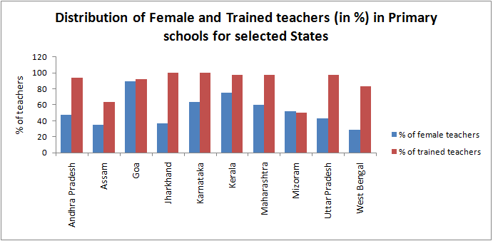
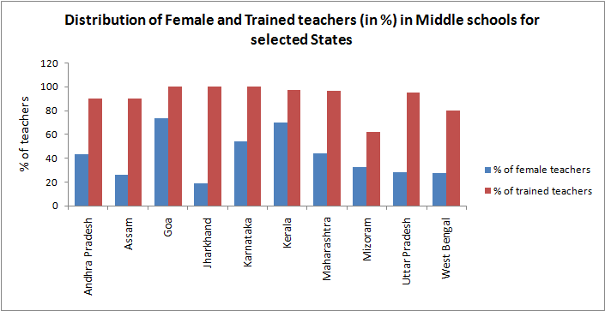

Slide 6
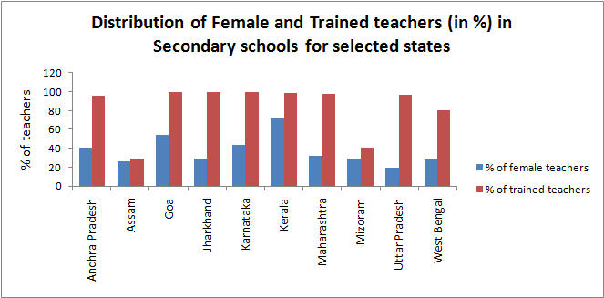
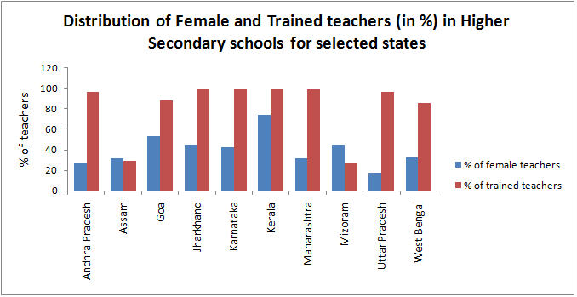

Slide 7
Some Observations
Rajasthan has a high number of total teachers in middle schools, possibly because of a high number of middle schools in the state. Also most of the students gets a job (generally in family business) after passing middle schools and makes a dropout to high schools.
UP and West Bengal has relatively low % of female teachers that shows these states’ education were predominantly conservative, while Kerala and Goa has more female based education system.
All states follows a decreasing trend in terms of total teachers in higher degree of education, while in Delhi and Haryana, the trends are actually opposite.
While all the eastern states are low in % of trained teachers, surprisingly Assam has about 90% of trained teachers in middle schools due to a few amount of middle schools.
West Bengal has extremely low amount of teachers in middle schools due to the Govt. policies like upgradation of middle schools to high schools.
Maharashtra has a good distribution in terms of female, trained and total number of teachers except female teachers’ % has gone down in HS schools, probably because the authorities view of underestimating women that they can not control the whole class.

Slide 8
THANK YOU

